Slide 1
Arden’s Theorem in Theory of Computation

Slide 2
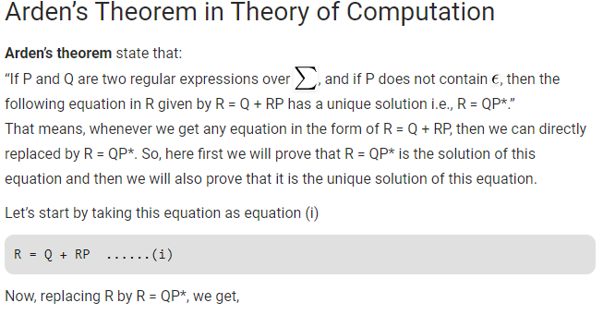

Slide 3
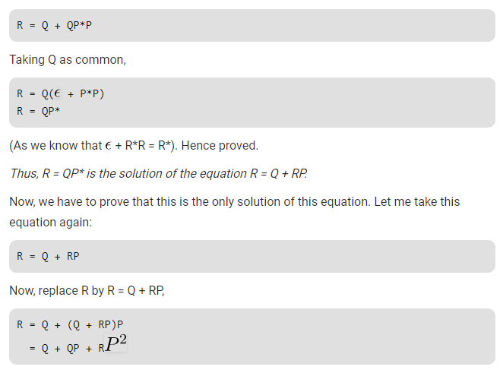

Slide 4
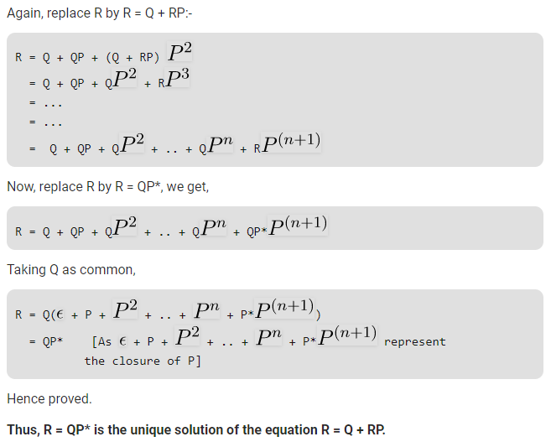

Slide 5
